Slide 1

Restaurant & Consumer Data Project
By -
Mutthavarapu Navya Sri

Slide 2
Why Data Science?
Data Science is a fast-growing, high-demand field that turns raw data into meaningful insights, smarter decisions, and intelligent automation. For those who enjoy problem-solving, coding, and finding patterns, it provides a chance to build impactful, future-proof careers in a data-driven world.

Slide 3
Objective
To organize restaurant-related consumer data from multiple CSV files into a relational SQL database.
Analyze consumer–restaurant interactions using SQL.
To perform SQL-based data analysis using WHERE, JOINs, Aggregations, CTEs,
Window Functions.
To derive actionable insights such as:
Consumer behavior patterns
Restaurant performance
Cuisine preferences
Rating trends
To prepare a recommendation-style analytical system using SQL.

Slide 4
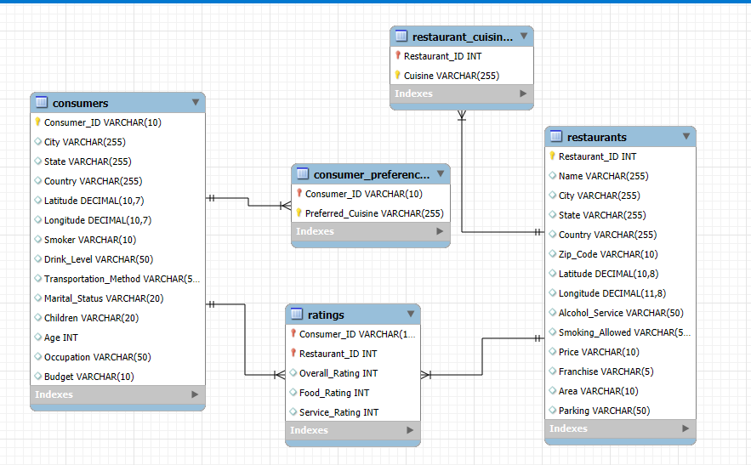
ER Diagram

Slide 5
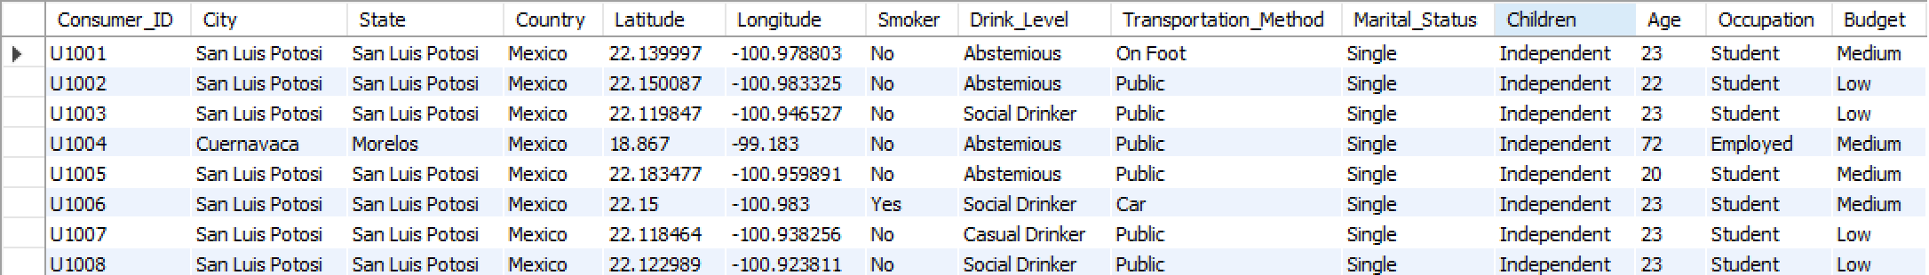
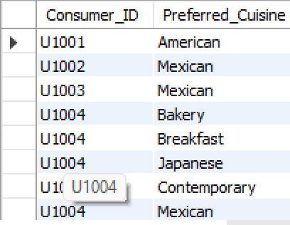
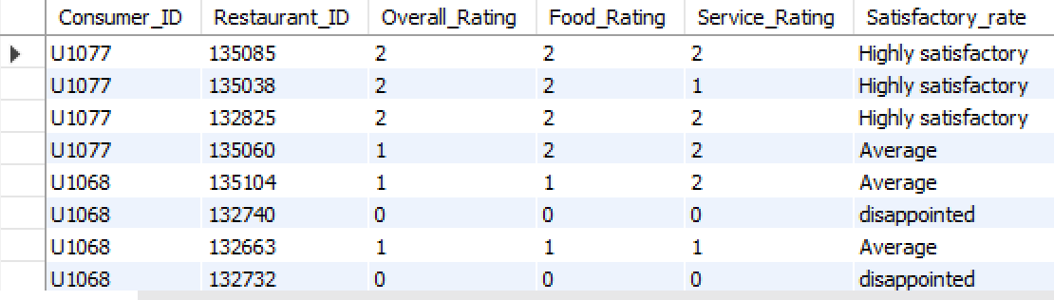
Tables
Consumers
Consumer_ preferences
Ratings

Slide 6
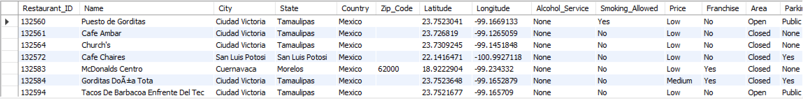
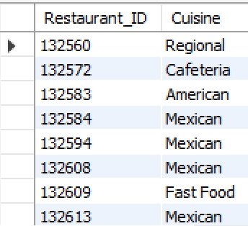
Restaurants
Restaurant_ preferences

Slide 7
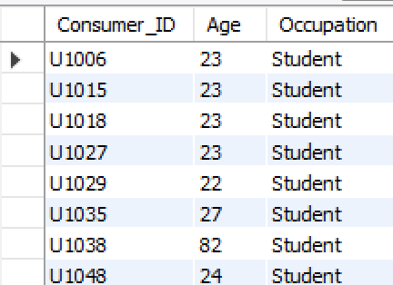
Using the WHERE clause to filter data based on specific criteria.
Find the Consumer_ID, Age, and Occupation of all consumers who are 'Students' AND are 'Smokers'.

Slide 8
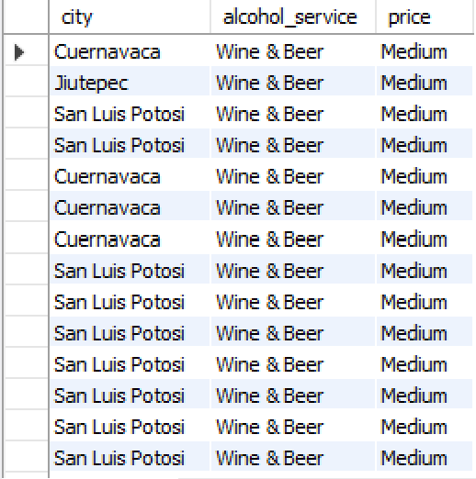
List the Name, City, Alcohol_Service, and Price of all restaurants that serve 'Wine & Beer' and have a 'Medium' price level.

Slide 9
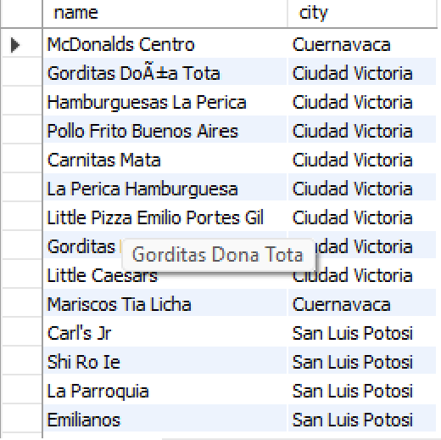
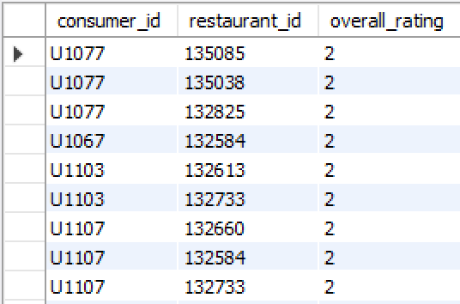
Find the names and cities of all restaurants that are part of a 'Franchise'
Show the Consumer_ID, Restaurant_ID, and Overall_Rating for all ratings where the Overall_Rating was 'Highly Satisfactory' (which corresponds to a value of 2, according to the data dictionary).

Slide 10
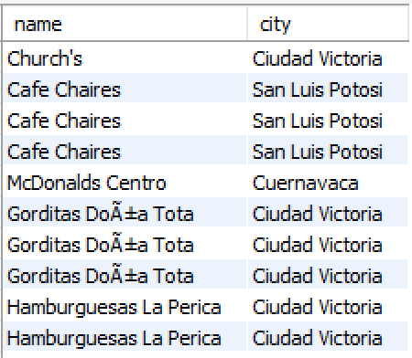
Questions JOINs with Subqueries
List the names and cities of all restaurants that have an Overall_Rating of 2 (Highly Satisfactory) from at least one consumer.

Slide 11
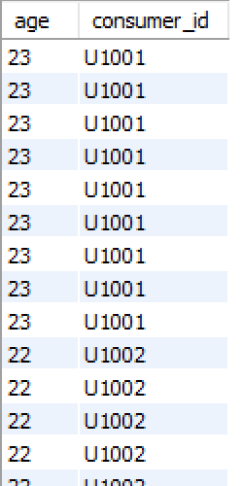
Find the Consumer_ID and Age of consumers who have rated restaurants located in 'San Luis Potosi’.

Slide 12
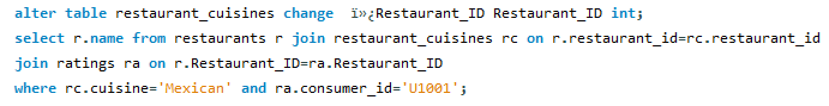
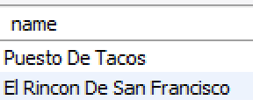
List the names of restaurants that serve 'Mexican' cuisine and have been rated by consumer 'U1001’.

Slide 13
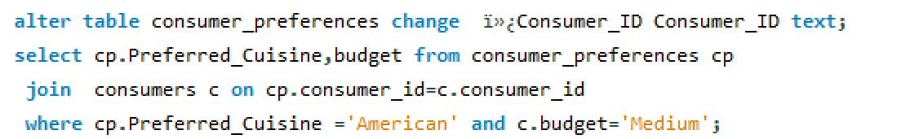
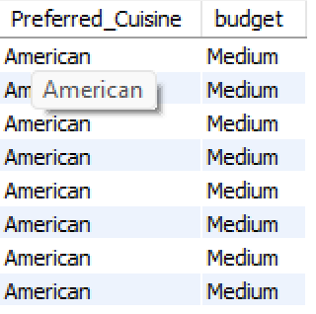
Find all details of consumers who prefer 'American' cuisine AND have a 'Medium' budget.

Slide 14
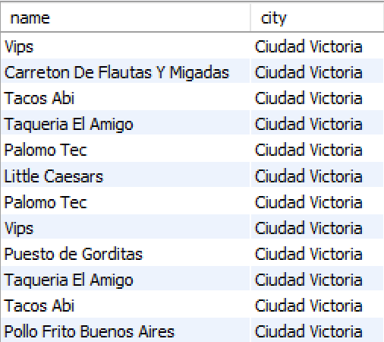
List restaurants (Name, City) that have received a Food_Rating lower than the average Food_Rating across all rated restaurants.

Slide 15
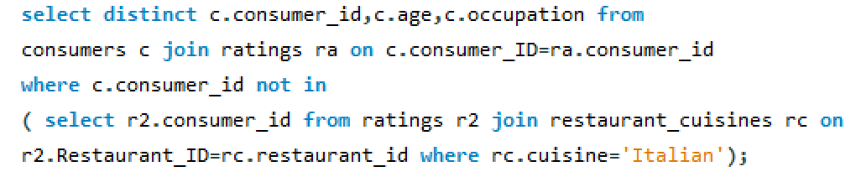
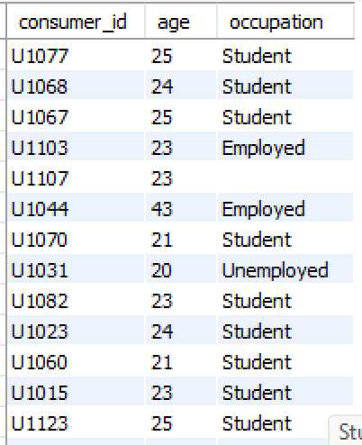
Find consumers (Consumer_ID, Age, Occupation) who have rated at least one restaurant but have NOT rated any restaurant that serves 'Italian' cuisine.

Slide 16
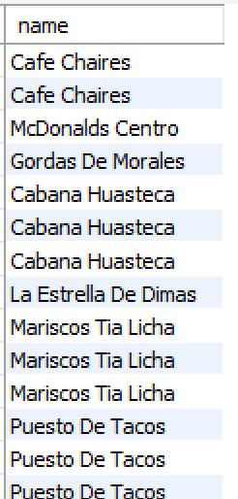
List restaurants (Name) that have received ratings from consumers older than 30.

Slide 17
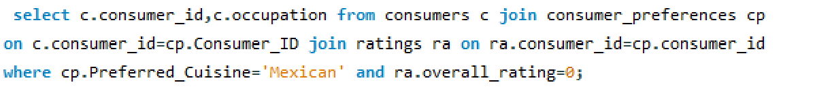
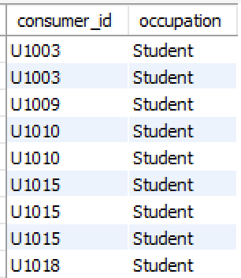
Find the Consumer_ID and Occupation of consumers whose preferred cuisine is 'Mexican' and who have given an Overall_Rating of 0 to at least one restaurant (any restaurant).

Slide 18
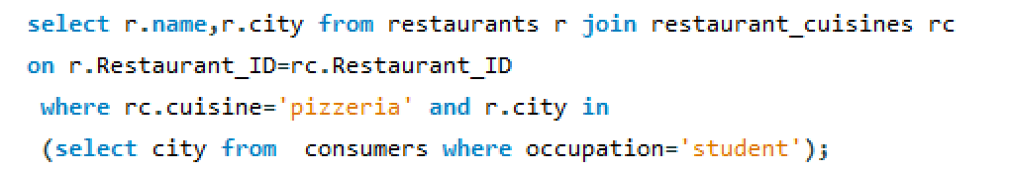
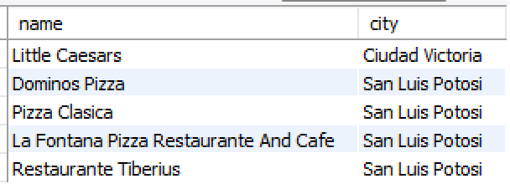
List the names and cities of restaurants that serve 'Pizzeria' cuisine and are located in a city where at least one 'Student' consumer lives.

Slide 19
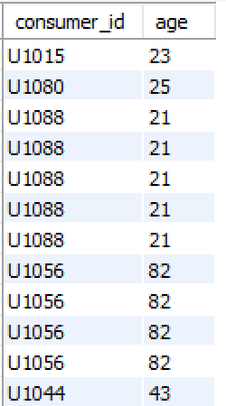
Find consumers (Consumer_ID, Age) who are 'Social Drinkers' and have rated a restaurant that has 'No' parking.

Slide 20
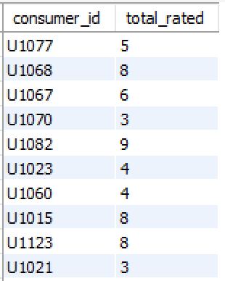
Emphasizing WHERE Clause and Order of Execution
List Consumer_IDs and the count of restaurants they've rated, but only for consumers who are 'Students'. Show only students who have rated more than 2 restaurants.

Slide 21
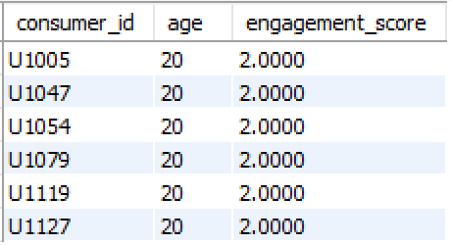
We want to categorize consumers by an 'Engagement_Score' which is their Age divided by 10 (integer division). List the Consumer_ID, Age, and this calculated Engagement_Score, but only for consumers whose Engagement_Score would be exactly 2 and who use 'Public' transportation.

Slide 22
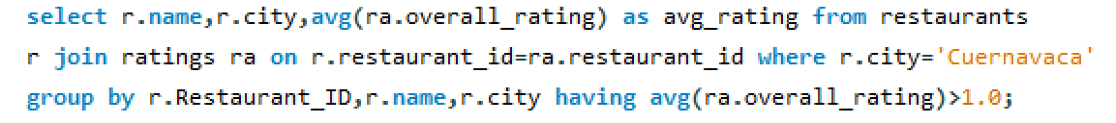
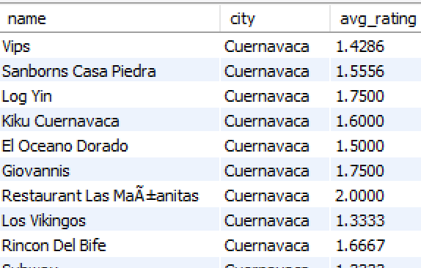
For each restaurant, calculate its average Overall_Rating. Then, list the restaurant Name, City, and its calculated average Overall_Rating, but only for restaurants located in 'Cuernavaca' AND whose calculated average Overall_Rating is greater than 1.0.

Slide 23
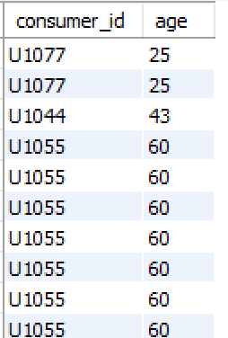
Find consumers (Consumer_ID, Age) who are 'Married' and whose Food_Rating for any restaurant is equal to their Service_Rating for that same restaurant, but only consider ratings where the Overall_Rating was 2.

Slide 24
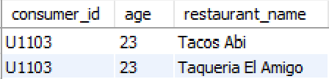
List Consumer_ID, Age, and the Name of any restaurant they rated, but only for consumers who are 'Employed' and have given a Food_Rating of 0 to at least one restaurant located in 'Ciudad Victoria’.

Slide 25
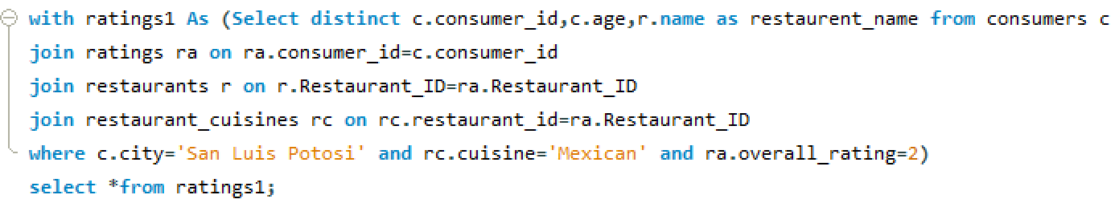
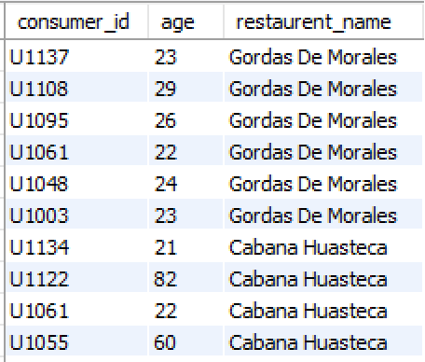
Derived Tables, CTEs, Window Functions
Using a CTE, find all consumers who live in 'San Luis Potosi'. Then, list their Consumer_ID, Age, and the Name of any Mexican restaurant they have rated with an Overall_Rating of 2.

Slide 26
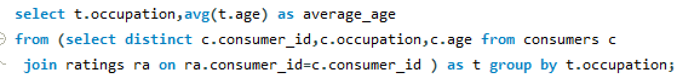
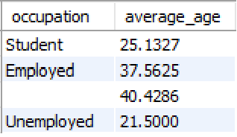
For each Occupation, find the average age of consumers. Only consider consumers who have made at least one rating. (Use a derived table to get consumers who have rated).

Slide 27
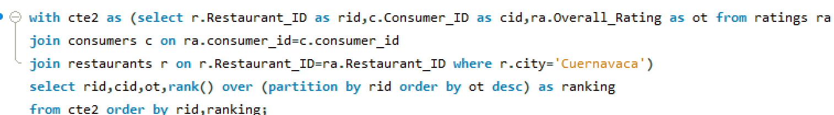
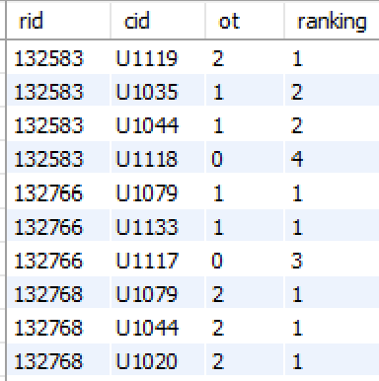
Using a CTE to get all ratings for restaurants in 'Cuernavaca', rank these ratings within each restaurant based on Overall_Rating (highest first). Display Restaurant_ID, Consumer_ID, Overall_Rating, and the RatingRank.

Slide 28
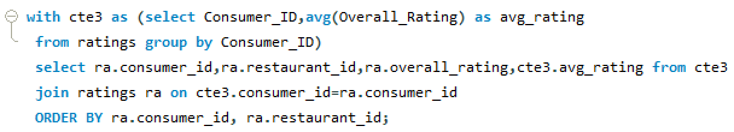
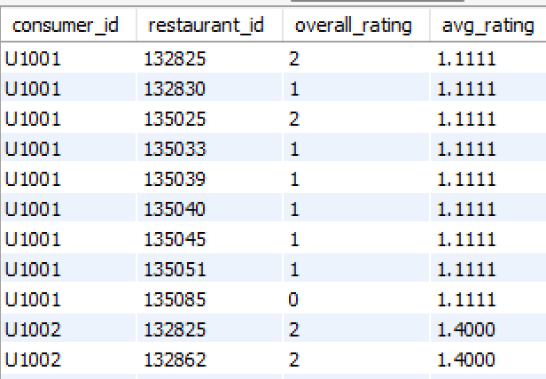
For each rating, show the Consumer_ID, Restaurant_ID, Overall_Rating, and also display the average Overall_Rating given by that specific consumer across all their ratings.

Slide 29
Final Insights and recommendations
Consumer preferences and budget shape their ratings, so restaurants should align menus and pricing with target segments.
Service quality drives overall satisfaction, making staff training and faster service essential improvements.
Mexican and American cuisines show highest demand, suggesting expansion in cities with limited options.
Independent restaurants often outperform franchises in food quality and can use this advantage in marketing.
Highly engaged consumers reveal rating patterns that can power a simple recommendation system to improve customer targeting.

Slide 30
Conclusion
Consumer preferences, budget, and behavior strongly influence restaurant choices and ratings.
Service quality is the biggest driver of overall satisfaction and needs the most improvement.
Mexican and American cuisines show the highest demand and strong performance trends.
Independent restaurants often outperform franchises in food and overall experience.
Data-driven insights can power personalized recommendations and support strategic restaurant expansion.

Slide 31

THANK YOU

